Slide 1
Capstone Project
Netflix Movies And TV Shows Clustering
Ankush

Slide 2

DISCUSSION POINTS
About Netflix
Data Summary
Exploratory data analysis
PCA
Cluster
Recommend system

Slide 3


Netflix
Netflix is an American subscription streaming service and production company. Launched on August 29, 1997, it offers a film and television series library through duration deals as well as its own productions, known as Netflix Originals. Netflix was founded on the aforementioned date by Reed Hastings and Marc Randolph in Scotts Valley,California.
As of December 31, 2021, Netflix had over 221.8 million subscribers worldwide.
Netflix can be accessed via internet browsers on computers, or via application software installed on smart TVs, set-top boxes connected to television, tablet, computers, smartphone etc.

Slide 4

DATA SUMMARY
show_id : Unique ID for every Movie / Tv Show
type : Identifier - A Movie or TV Show
title : Title of the Movie / Tv Show
director : Director of the Movie
cast : Actors involved in the movie / show
country : Country where the movie / show was produced

Slide 5

DATA SUMMARY
date_added : Date it was added on Netflix
release_year : Actual Release Year of the movie / show
rating : TV Rating of the movie / show
duration : Total Duration - in minutes or number of seasons
listed_in : Genre
Description: The Summary description

Slide 6
Problem Description
This dataset consists of tv shows and movies available on Netflix as of 2019. The dataset is collected from Flexible which is a third-party Netflix search engine.
In 2018, they released an interesting report which shows that the number of TV shows on Netflix has nearly tripled since 2010. The streaming services number of movies has decreased by more than 2,000 titles since 2010, while its number of TV shows has nearly tripled. It will be interesting to explore what all other insights can be obtained from the same dataset.

Slide 7
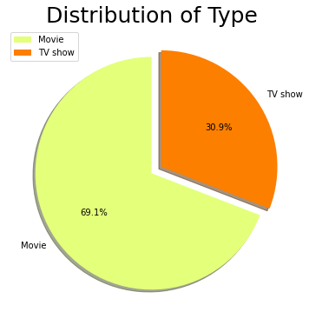
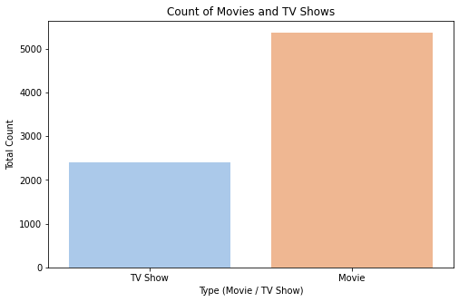
EDA

Slide 8
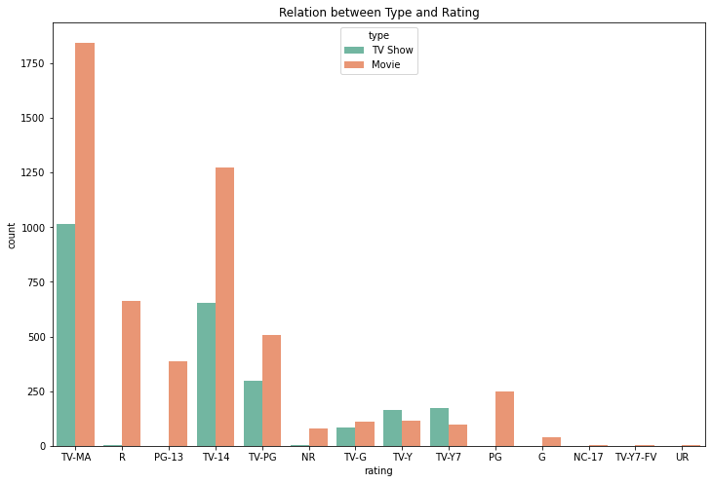
Continue……
Most of the Movies and tv shows have rating of TV-MA (Mature Audience), However, for the younger audience (under the age of 17), it is the opposite, there are slightly more TV shows than there are movies

Slide 9
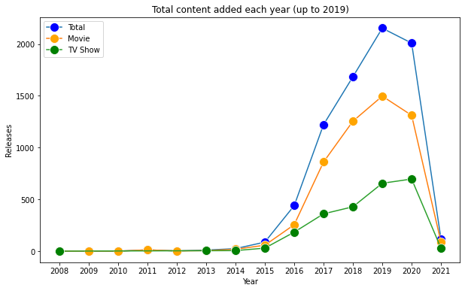
Continue….
Based on this graph, we can see that the popular streaming platform started gaining traction after 2014. Since then, the amount of content added has been tremendous

Slide 10
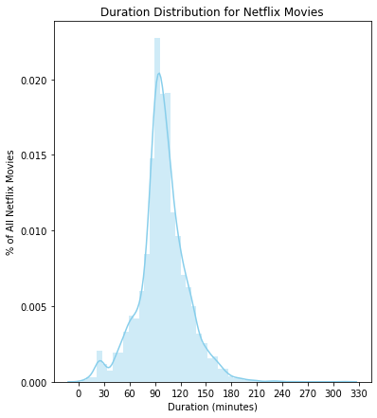
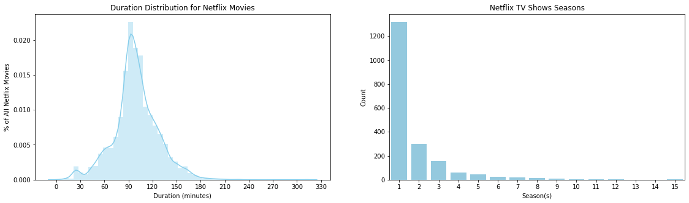
Continue……

Slide 11
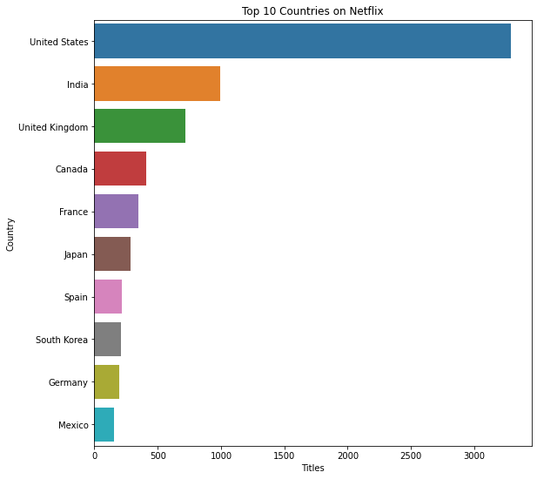
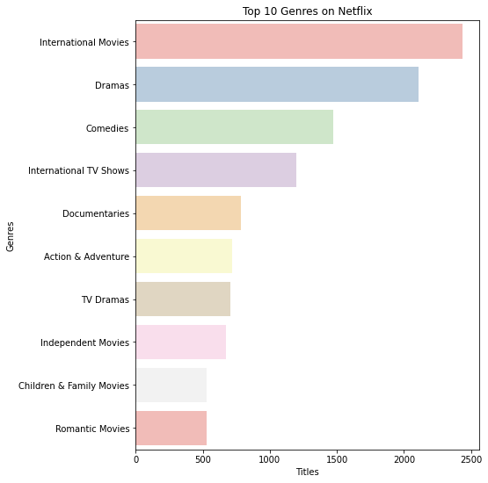
Continue…..

Slide 12
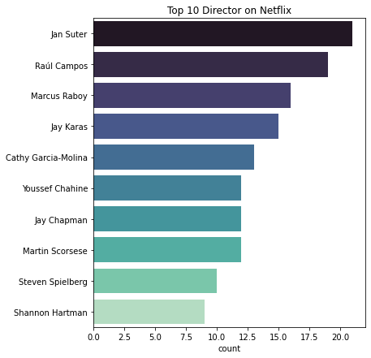
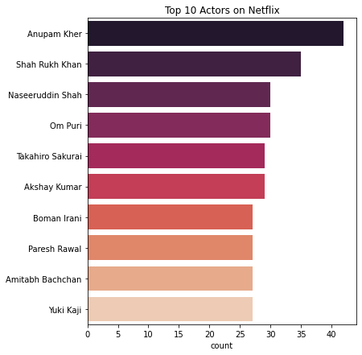
Continue……

Slide 13
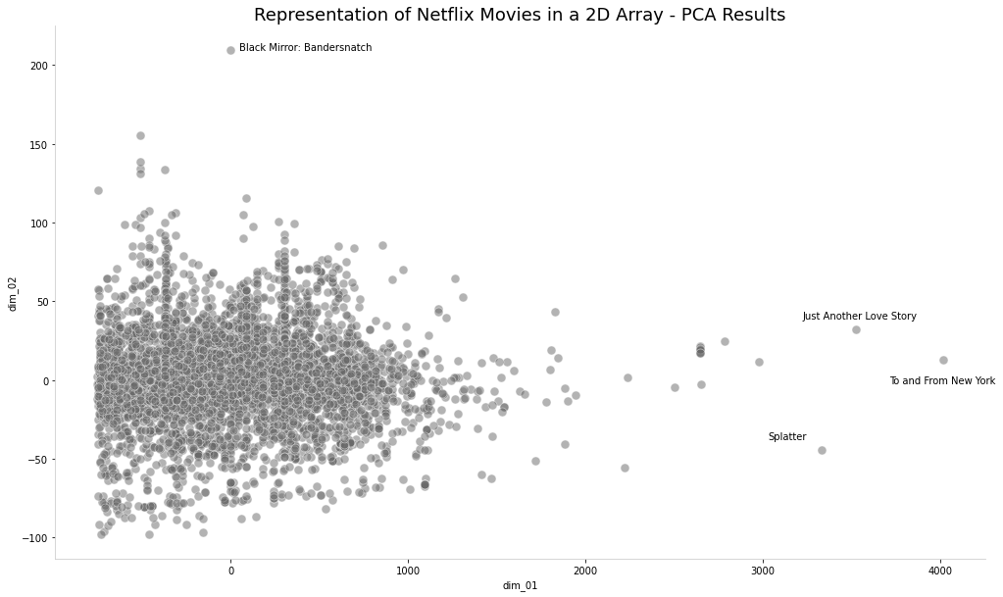
PCA

Slide 14
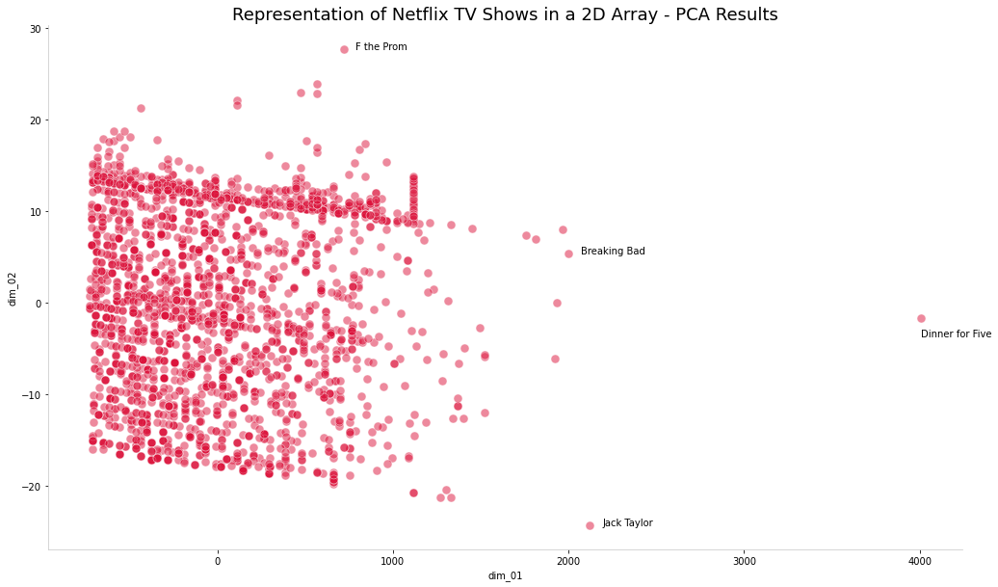
PCA

Slide 15
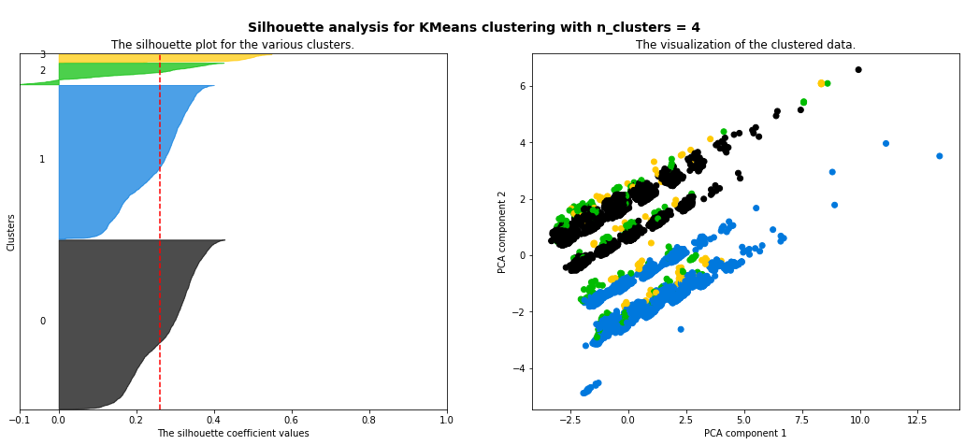
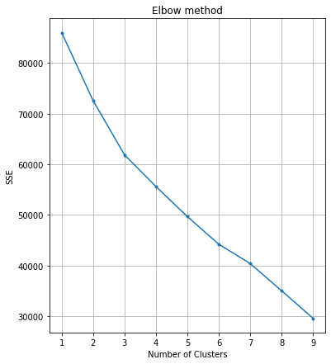
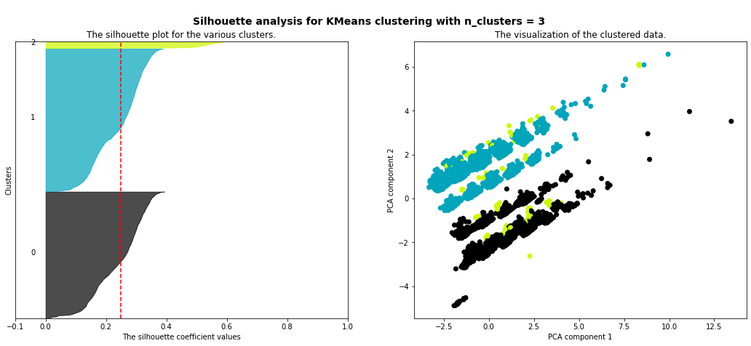
Cluster

Slide 16
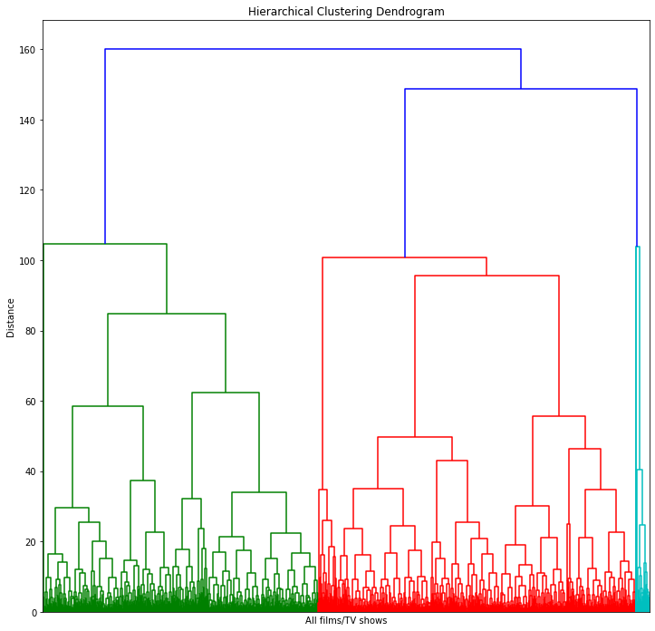
Dendrogram

Slide 17
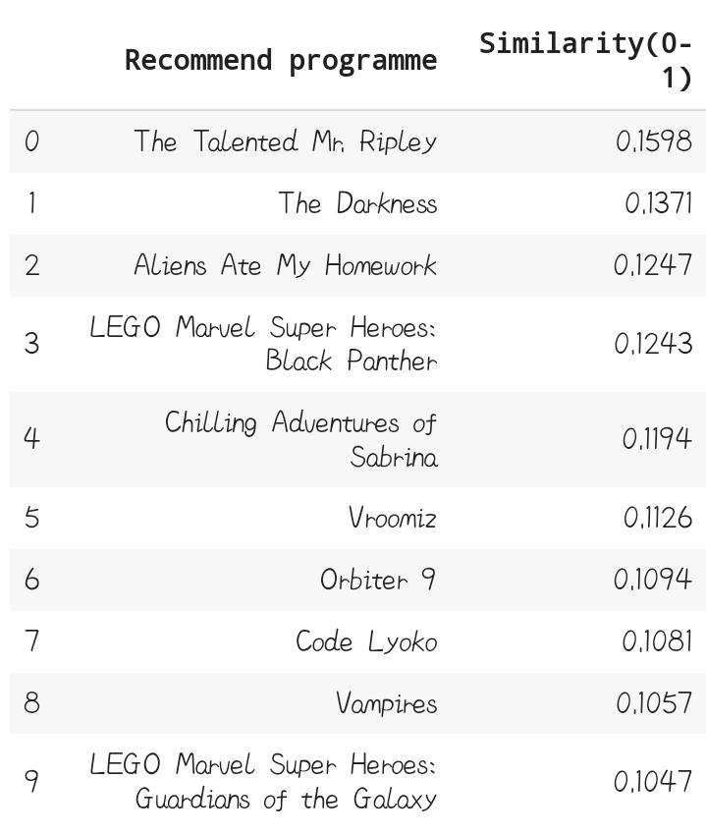
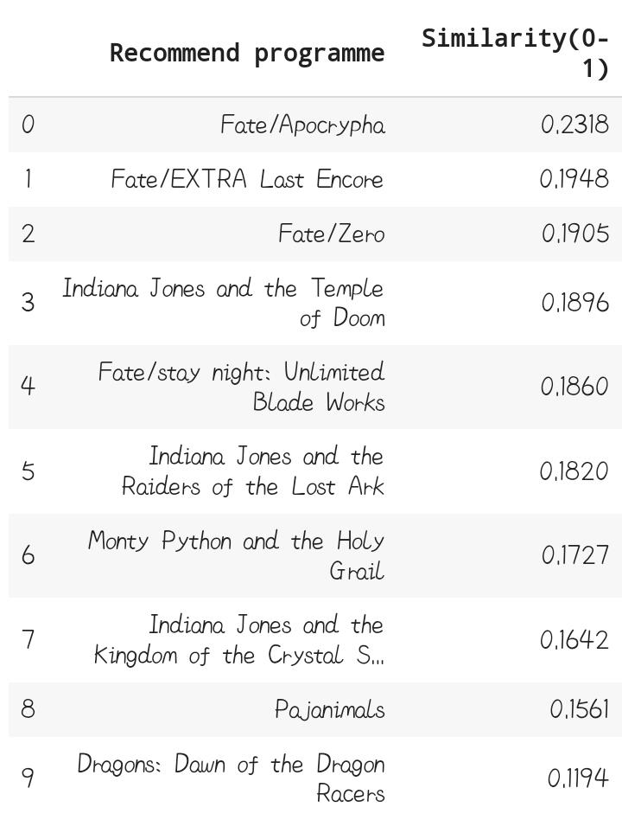
Recommend System
Search Movie - Avengers Infinity War
Search Movie - Indiana Jones and The last Crusade

Slide 18
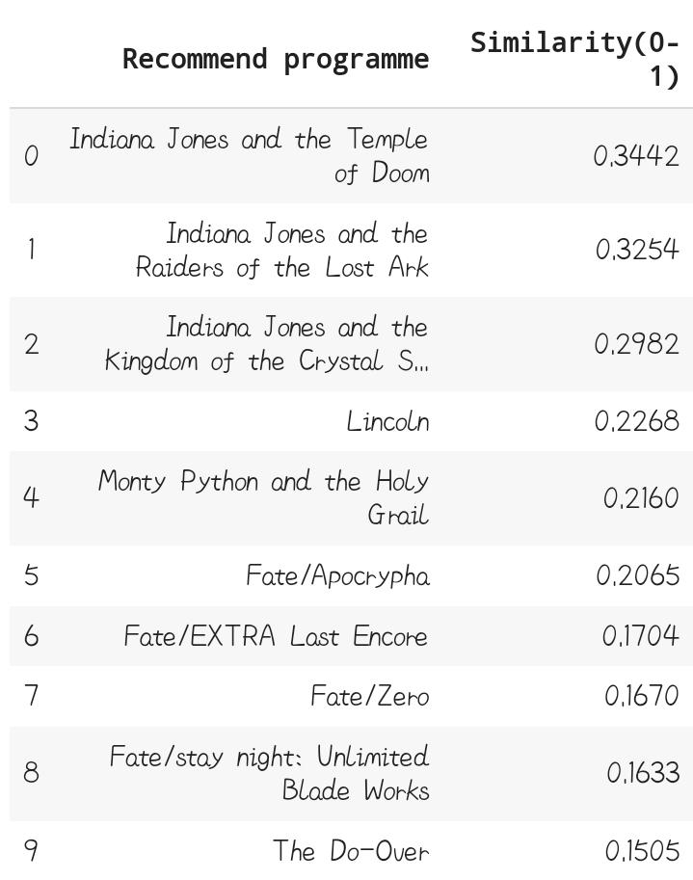

As above recommendation engine is constructed based on description only, it probably wouldn't suggest the movies in series, but movies with more similar keywords.
So, we make another Recommend System which suggest movies in series.
Search Movie - Indiana Jones and The last Crusade

Slide 19
Conclusion
It's clear that Netflix has grown over the years. We can see it from the data that the company took certain approaches in their marketing strategy to break into new markets around the world. Based on an article from Business Insider, Netflix had about 158 million subscribers worldwide with 60 million from the US and almost 98 million internationally. Netflix's original subscriber base was based solely in the United States following its IPO. A large part of its success was due to the decision to expand to international markets. The popular markets prioritizes what content the company will release. In this case, we can see that a good amount of international movies and TV shows were added over the years as part of Netflix's global expansion.

Slide 20
Thank you

